Slide 1
Photomicrographs of Plant Seeds
Kiwano
Permission to reproduce original photomicrographs used to make this collection may be obtained from
Dr. David O. Norris at
david.norris@colorado.edu

Slide 2
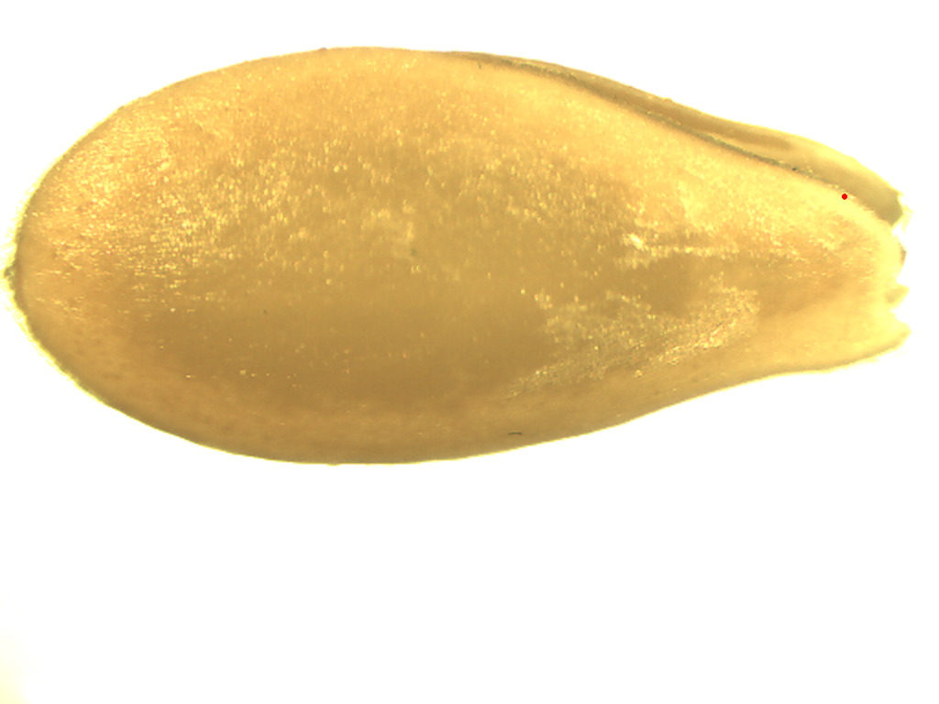
10X
Kiwano seed
Notes:
S36. Kiwano (horned melon) seed (Cucumis metuliferus).

Slide 3
Kiwano seed
Notes:
S27. Kiwano (horned melon) seed (Cucumis metuliferus). SEM. SEM prepared by Dr. Patrick Kociolek and Joshua Stepanek.

Slide 4
A
B
Kiwano seed
Notes:
S38. Kiwano (horned melon) seed (Cucumis metuliferus) surface texture SEM. B. is higher magnification of A. SEMs prepared by Dr. Patrick Kociolek and Joshua Stepanek.

